Slide 1
Medical Image Analysis with CNNs June 26, 2020
MMCi Applied Data Science
Matthew Engelhard

Slide 2
Today
How do we train a model to classify medical images?
How do we get labels for medical images, and what do they mean (i.e., what is “ground truth”)?
How do we measure performance?
Can we understand why the model makes a certain prediction?
Later: What else can CNNs do in medicine (beyond classification)?

Slide 3
Medical Image Classification
Identifying Skin Cancer

Slide 4
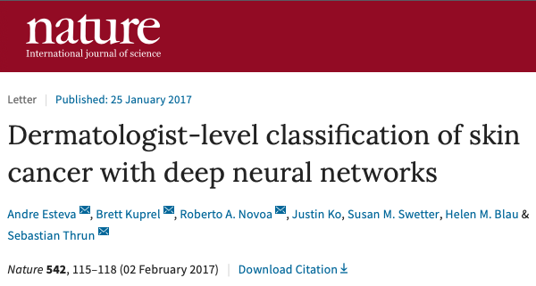
Notes:
Allow us to illustrate a few things:
How to repurpose an existing CNN model
Nuances of evaluation in medical settings
Interpreting results
How to open the black box

Slide 5
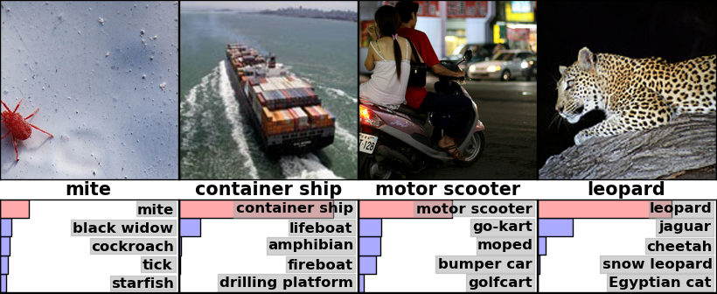
Classification: predict the label associated with each image
Notes:
Output is distribution over output classes
Note that some images match multiple labels
Training data: whole-image labels

Slide 6

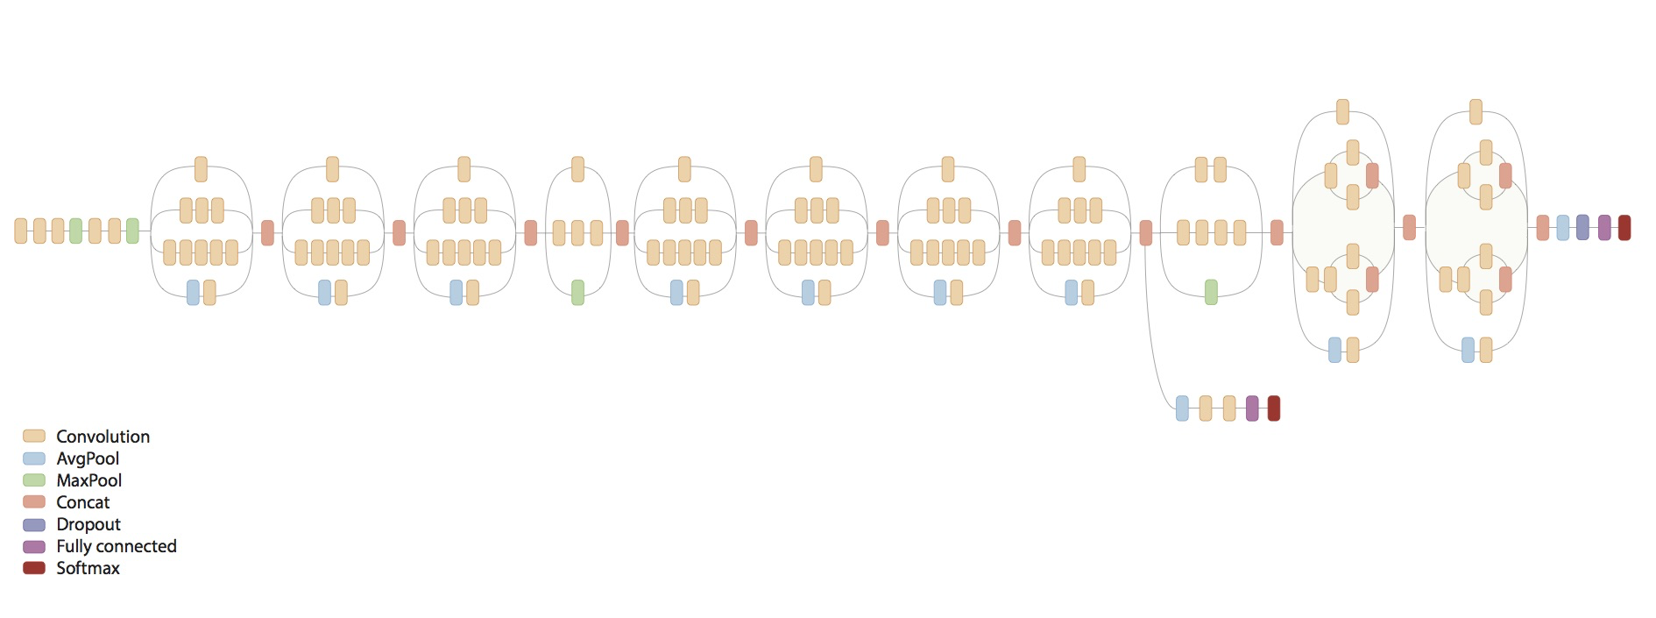
Take a model trained on naturalistic images...
Lily
Notes:
What’s the strategy?
Well, training these models takes millions of images
If we have that many, GREAT! -> train from scratch, let it learn a new, effective hierarchy from the ground up
More often, we just don’t have the volume, so instead we want to take an existing model and “fine-tune” it to work for our new problem

Slide 7
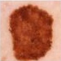
…and repurpose it to evaluate medical images
Melanoma
Notes:
First, WHY are we doing this?
Good idea to reuse our filters
Lots of things we’ve discovered in these architectures
So here, we’re doing the same thing – not only are we taking the model structure, i.e. the architecture, but also the trained parameters

Slide 8
Repurposing our model
Step 1: Modify the architecture
Step 2: Fine-tune the parameters

Slide 9
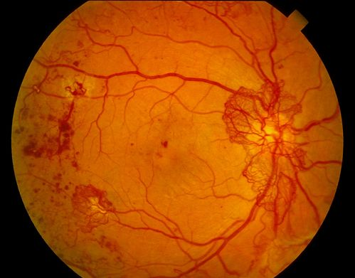
Classifier Output:
Two-Class (e.g. Yes/No)
Diabetic retinopathy? (Yes/No)
Gulshan et al. JAMA (2016)

Slide 10
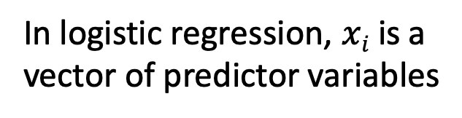

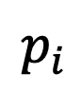

Two-Class Predictions
$$p_{i}$$
$$σ$$
$$σ\left(zi\right)=\frac{e^{zi}}{1+e^{zi}}$$
z_{i}
b₁
b_{M}
x_{i1}
x_{iM}
In logistic regression, $xi$ is a
vector of predictor variables

Slide 11
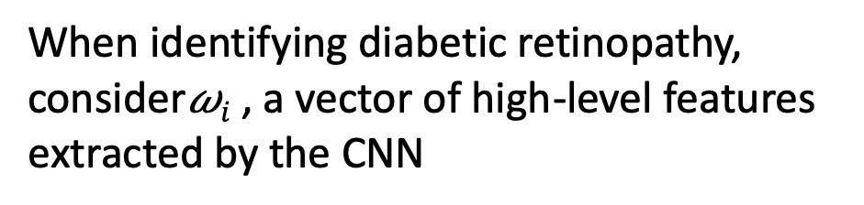
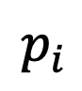

Two-Class Predictions
$$p_{i}$$
$$σ$$
z_{i}
$$σ\left(zi\right)=\frac{e^{zi}}{1+e^{zi}}$$
b₁
b_{M}
𝜔_{i1}
𝜔_{iM}
When identifying diabetic retinopathy,
consider𝜔$i$ , a vector of high-level features
extracted by the CNN
Convolutional Neural Network

Slide 12
Classifier Output:
Multi-Class (ImageNet)
Image Label? (1000 classes)

Slide 13

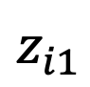
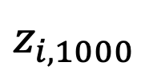
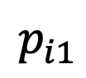
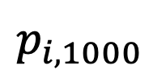
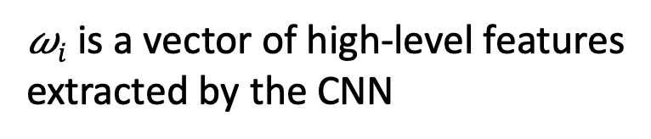
Multi-Class Predictions
$$p_{i1}$$
$$p_{i,1000}$$
$$pi = softmax(zi)$$
$$z_{i1}$$
$$z_{i,1000}$$
fully connected
𝜔_{i1}
𝜔_{iM}
𝜔$i$ is a vector of high-level features
extracted by the CNN
Convolutional Neural Network

Slide 14
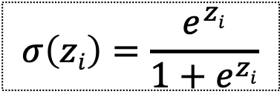
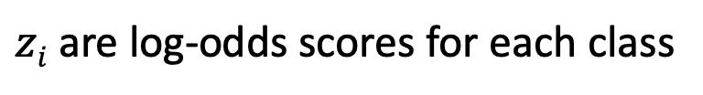
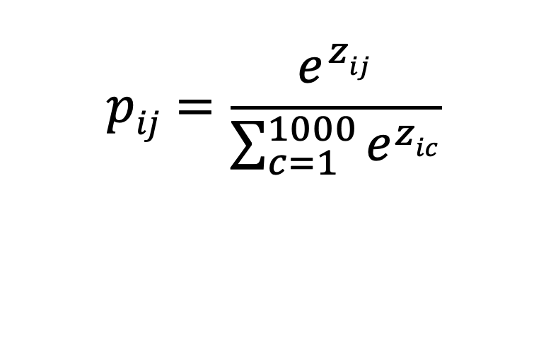
Multi-Class Predictions
$$pij=\frac{e^{zij}}{\sum_{c=1}^{1000}{e^{zic}}}$$
$$p_{i1}$$
$$p_{i,1000}$$
$$pi = softmax(zi)$$
$$σ\left(zi\right)=\frac{e^{zi}}{1+e^{zi}}$$
$$z_{i1}$$
$$z_{i,1000}$$
$zi$ are log-odds scores for each class
fully connected
𝜔_{i1}
𝜔_{iM}
𝜔$i$ is a vector of high-level features
extracted by the CNN
Convolutional Neural Network

Slide 15
Classifier Output:
Multi-Class (Lesion Type)
Type of Skin Lesion? (757 classes)
Esteva et al. Nature (2017)

Slide 16
Step 1: Modify the Architecture
$$p_{i1}$$
$$p_{i,1000}$$
1000 training classes
757 training classes
$$pi = softmax(zi)$$
$$z_{i1}$$
$$z_{i,1000}$$
fully connected
𝜔_{i1}
𝜔_{iM}
𝜔$i$ is a vector of high-level features
extracted by the CNN
Convolutional Neural Network

Slide 17
Step 1: Modify the Architecture
1000 training classes
757 training classes
𝜔_{i1}
𝜔_{iM}
𝜔$i$ is a vector of high-level features
extracted by the CNN
Convolutional Neural Network

Slide 18
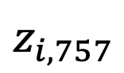
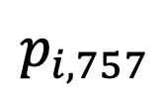
Step 1: Modify the Architecture
$$p_{i1}$$
$$p_{i,757}$$
$$pi = softmax(zi)$$
New layers with randomly initialized weights
$$z_{i1}$$
$$z_{i,757}$$
fully connected
𝜔_{i1}
𝜔_{iM}
𝜔$i$ is a vector of high-level features
extracted by the CNN
Convolutional Neural Network

Slide 19
Step 2: Fine-tune the Parameters “pre-training”, or “transfer learning”
Layer 3
Feature “Maps”
Malignant or Benign?
Layer 2
Feature “Maps”
Layer 3 Filters
Layer 1
Feature “Maps”
Layer 2 Filters
Input Image
Layer-1 Filters
Notes:
Need to work on this

Slide 20
Step 2: Fine-tune the Parameters “pre-training”, or “transfer learning”
Layer 3
Feature “Maps”
Malignant or Benign?
Layer 2
Feature “Maps”
Layer 3 Filters
Layer 1
Feature “Maps”
Layer 2 Filters
Feature detectors at the top of the network are typically highly specialized for a particular task
Input Image
Layer-1 Filters

Slide 21
Step 2: Fine-tune the Parameters “pre-training”, or “transfer learning”
Layer 3
Feature “Maps”
Malignant or Benign?
Layer 2
Feature “Maps”
Layer 3 Filters
Layer 1
Feature “Maps”
Layer 2 Filters
But low-level detectors extract features universal to all images
Input Image
Layer-1 Filters

Slide 22
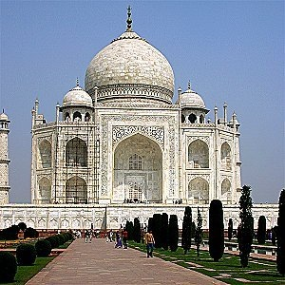

A filter that detects edges may be useful for many classification tasks.
https://docs.gimp.org/en/plug-in-convmatrix.html

Slide 23
Pre-training, in brief
fine-tuning a pre-trained model tends to be at least as good as learning from scratch
(empirical result)
2) freeze early layers and fine-tune later layers
more data → fine-tune more layers
3) best tuning depth depends on the application, and should be explored
Notes:
~130k images -> they fine-tune all layers

Slide 24
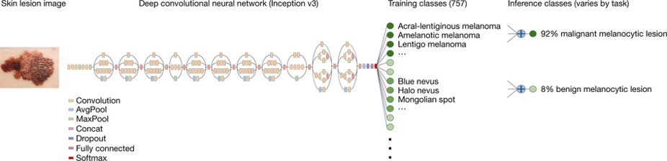
Repurposing the Inception v3 CNN
Begin with a model trained on ImageNet (to classify everyday images)
Modify the architecture to match the new number of training classes
Fine-tune parameters using images of skin lesions
Notes:
Briefly mention additional details, e.g. learning rate (0.001), decay factor, optimizer, random rotation and flip of images

Slide 25
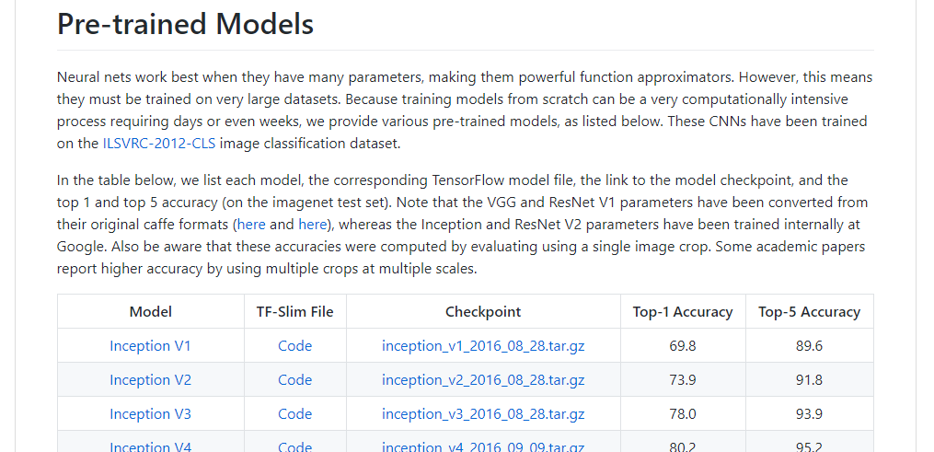
Inception v3 and many other models are freely available
TF-Slim Code:
Defines the model architecture
Checkpoint File:
Trained model parameters
https://github.com/tensorflow/models/tree/master/research/slim#Pretrained
Notes:
CODE -> architecture
CHECKPOINT -> parameters

Slide 26
“Ground Truth” in Medicine
What are the labels?

Slide 27
Esteva et al: Two Types of Labels
All images: dermatologists’ annotations
Some images: biopsy results
Notes:
We’d like a “gold-standard” label for each image, but this is hard to come by

Slide 28
Two Rounds of Evaluation
Model development: predict dermatologists’ annotations:
Three-class disease partition
Nine-class disease partition
Model evaluation: predict biopsy result (benign vs malignant)
Keratinocyte carcinoma vs benign seborrheic keratosis
Malignant melanoma vs benign nevus
Standard images
Dermoscopy
Notes:
The “gold standard” is hard to come by… and so they do something that is pretty clever.
They’ll use the annotations for training – let’s assume they’re good enough

Slide 29
Model Development: Predict dermatologists’ annotations
$$x_{1}$$
$$y_{1}$$
9-fold cross-validation
757 training classes derived from dermatologists’ annotations
3 and 9-class validation partitions
two dermatologists
training set
validation set
$$x_{127,463}$$
$$y_{127,463}$$
Notes:
Note that this can require a lot of runs

Slide 30
Model Evaluation: Predict Biopsy Result
test set of 1942 biopsy-proven images
Performance of the trained model is compared to 21 dermatologists on a test set of biopsy-proven images
$$x_{1}$$
$$y_{1}$$
$$x_{1942}$$
$$y_{1942}$$
Notes:
Here we’re comparing to a larger number of dermatologists

Slide 31
Specifying training classes based on taxonomy of lesions
Disease Partitioning Algorithm:
Ascend the tree until the current node contains <1000 images across all child nodes. Add these images as a distinct training class.
This resulted in 757 training classes.
However, performance was assessed based on higher-level nodes.
Notes:
Go too far up and we’re identifying dissimilar things
Go too far down and we don’t have enough examples
Broader issue here – what’s the right level of prediction?

Slide 32
MALIGNANT LESION
CUTAENOUS LYMPHOMA
DERMAL
Use these as training classes?
-> Too few examples to learn effectively
T-CELL
B-CELL
ANGIOSARCOMA
MERKEL CELL CARCINOMA
Notes:
May also have similar appearance
Note that appearance is not the same as the taxonomy

Slide 33
Use these as training classes?
-> Too much variability in appearance
MALIGNANT LESION
CUTAENOUS LYMPHOMA
DERMAL
T-CELL
B-CELL
ANGIOSARCOMA
MERKEL CELL CARCINOMA

Slide 34
MALIGNANT LESION
CUTAENOUS LYMPHOMA
DERMAL
Use these as training classes.
-> Allows effective learning
T-CELL
B-CELL
ANGIOSARCOMA
MERKEL CELL CARCINOMA
Notes:
But evaluation still takes place at the benign / malignant level

Slide 35
Classification Results
Interpreting the ROC Curve

Slide 36
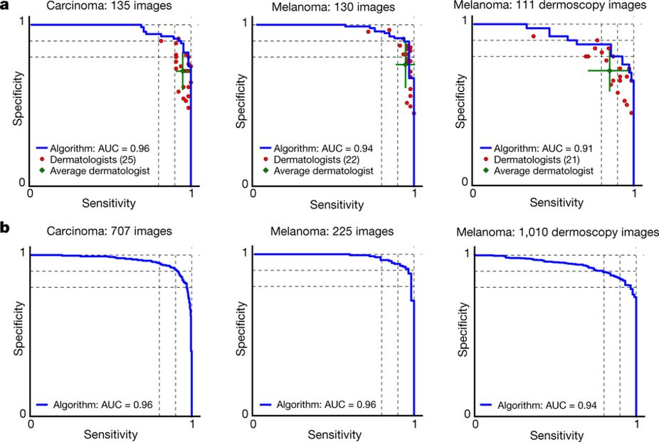
Results: CNN Performance vs Dermatologists
Notes:
Our CNN is tested against at least 21 dermatologists at keratinocyte carcinoma and melanoma recognition. For each test, previously unseen, biopsy-proven images of lesions are displayed, and dermatologists are asked if they would: biopsy/treat the lesion or reassure the patient.
Melanocytic test: 33 malignant melanomas and 97 benign nevi. A second melanocytic test using dermoscopic images is displayed for comparison: 71 malignant and 40 benign.

Slide 37
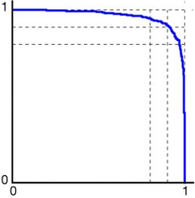
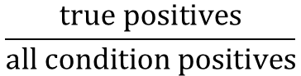
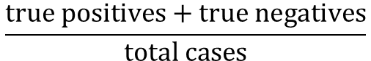
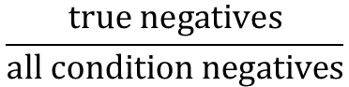
Evaluation Measures: Classification
Receiver Operating Characteristic (ROC) Curve
Sensitivity/Specificity Curve
Sensitivity, or True Positive Rate:
Specificity, or (1 – False Positive Rate):
Accuracy:
$$\frac{true positives}{all condition positives}$$
Sensitivity
True Positive Rate
Specificity
1 – False Positive Rate
$$\frac{true negatives}{all condition negatives}$$
$$\frac{true positives+true negatives}{total cases}$$
0 1
1 – Specificity
False Positive Rate
Sensitivity
True Positive Rate

Slide 38
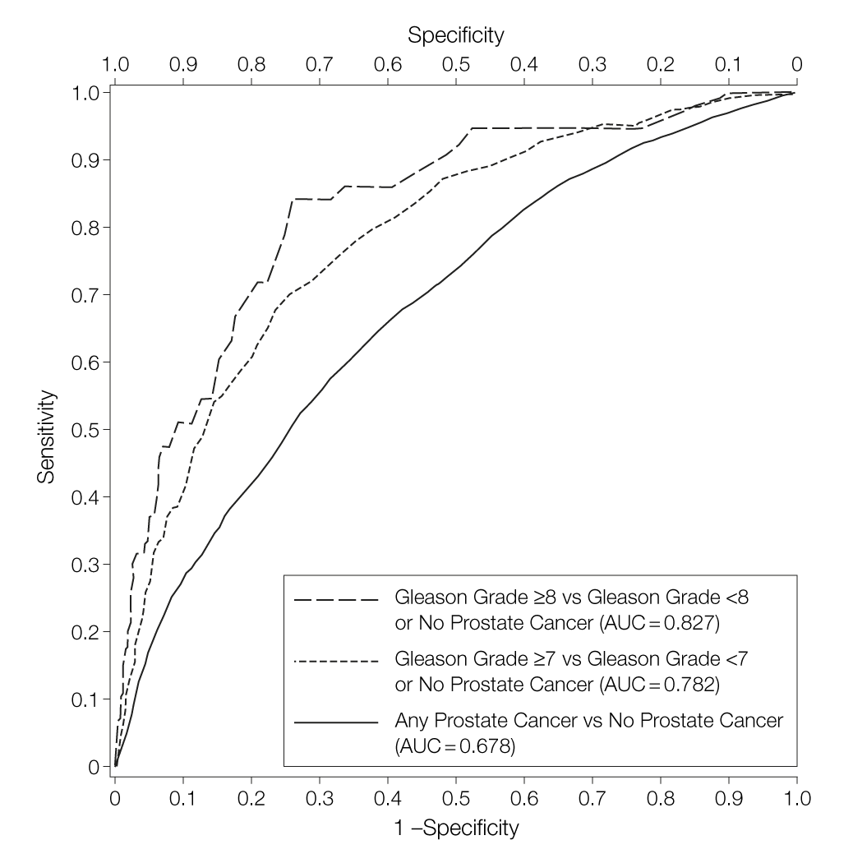
Receiver Operating Characteristic Curve for Prostate-Specific Antigen (PSA)
Thompson IM, Ankerst DP, Chi C, et al. Operating Characteristics of Prostate-Specific Antigen in Men With an Initial PSA Level of 3.0 ng/mL or Lower. JAMA. 2005;294(1):66–70. doi:10.1001/jama.294.1.66
Notes:
Let’s start by setting aside machine learning for a moment and thinking about a more traditional diagnostic.
Here we see the sensitivity versus specificity curve (or false positive rate) for prostate-specific antigen as used as a biomarker for prostate cancer
Most effective at identifying high grade cancer; less effective at identifying any cancer versus no cancer
But what do these terms mean?

Slide 39
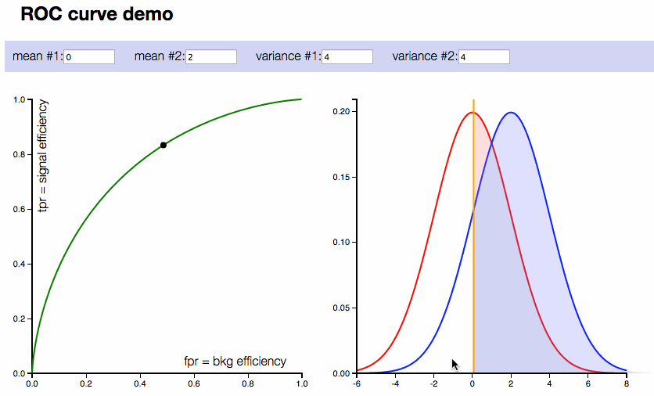
Set a “classification threshold” to distinguish between groups
http://arogozhnikov.github.io/2015/10/05/roc-curve.html

Slide 40
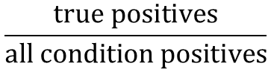
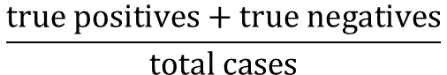
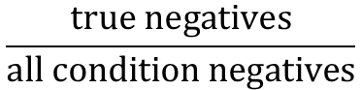
Once a threshold is set, we get a “confusion matrix”
Sensitivity, or True Positive Rate:
Specificity, or (1 – False Positive Rate):
Accuracy:
 | Condition Positive | Condition Negative
Prediction Positive | True Positive | False Positive
Prediction Negative | False Negative | True Negative
$$\frac{true positives}{all condition positives}$$
$$\frac{true negatives}{all condition negatives}$$
$$\frac{true positives+true negatives}{total cases}$$
Notes:
Review this, then talk about how this confusion matrix assumes that everyone has been assigned a prediction.
However, with something like PSA, we have flexibility in our assignment criterion – we can vary the PSA level that we consider to be POSITIVE.

Slide 41
Set a threshold on PSA
Make predictions:
Above threshold: cancer-positive
Below threshold: cancer-negative
Count true positives, true negatives, false positives, and false negatives
Calculate sensitivity and specificity
Plot point and repeat
Notes:
How do we completely characterize the diagnostic performance of PSA? Well, we explore all possible thresholds, which tells us about the tradeoff between sensitivity and specificity that we get when varying it.

Slide 42


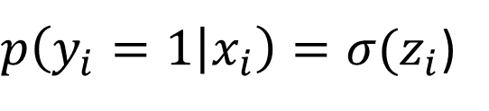
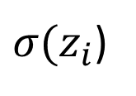
Set a threshold on classifier predictions
$p\left(y_{i}=1 | x_{i}\right)=σ(z_{i}$)
classification threshold
$σ(z_{i}$)
A low threshold favors sensitivity, because more points are predicted to be ones

Slide 43
Set a threshold on classifier predictions
$p\left(y_{i}=1 | x_{i}\right)=σ(z_{i}$)
classification threshold
$σ(z_{i}$)
A high threshold favors specificity, because more points are predicted to be zeros

Slide 44
Results: CNN Performance vs Dermatologists
Notes:
As we move top left to bottom right, we’re lowering our threshold
Move to the right – pick up one more true positive
Move down – pick up a false positive

Slide 45
Model Interpretation
How do the authors attempt to look inside the “black box”?

Slide 46
Machine Learning: A Black Box?
Skin Lesion Type
Notes:
Want to highlight the issue of interpretability
How can we trust a ”black box” diagnostic if we don’t know what’s happening inside?

Slide 47
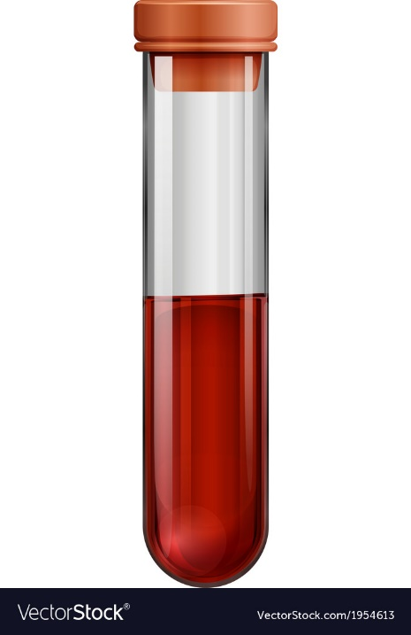
Prostate-specific antigen measurement: A Black Box?
PSA Level
Notes:
At the same time, I might question whether we fully understand even more traditional diagnostics.
For instance, I might know that PSA is an enzyme found in the prostate, but I have only a very rudimentary understanding of how PSA levels are detected, or how reliable a PSA measurement might be
gamma-seminoprotein or kallikrein-3 (KLK3), is a glycoprotein enzyme encoded in humans by the KLK3 gene

Slide 48
Two competing perspectives
Clinicians must fully understand how their diagnostic tools work
Clinicians must be sure these tools are valid and reliable
Notes:
At the end of the day there are two competing perspectives.
Those that think we must fully understand how these tools work to trust them
And those who think that we just need to know that they DO work.
But that means rigorously and repeatedly validating them, in a variety of settings – health systems, patient populations, other conditions

Slide 49
Saliency maps for example images
Saliency maps show gradients for each pixel with respect to the CNN’s loss function. Darker pixels represent those with more influence.
Q: How much does this visualization help us understand the model?

